Slide 1
Advanced AB testing in practice
By: Eltsefon Mark

Slide 2
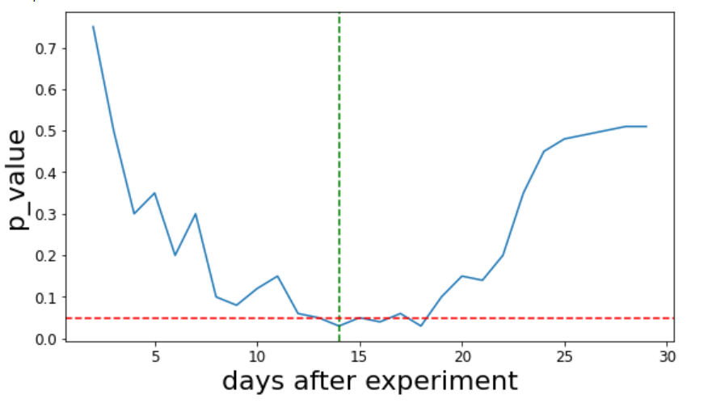
Novelty. What is it ?
Users will try new feature out just out of curiosity.
The effect of the new feature vs the effect that the feature is new?

Slide 3
Novelty. How to detect it?
Segment users in new vs returning
Calculate p value for these two hypothesis
Statistical significant difference for returning users and no difference for new users => compelling evidence that we witness the novelty effect

Slide 4
Novelty. How to grapple with it?
To run tests longer
Check treatment effect only on new users

